Slide 1

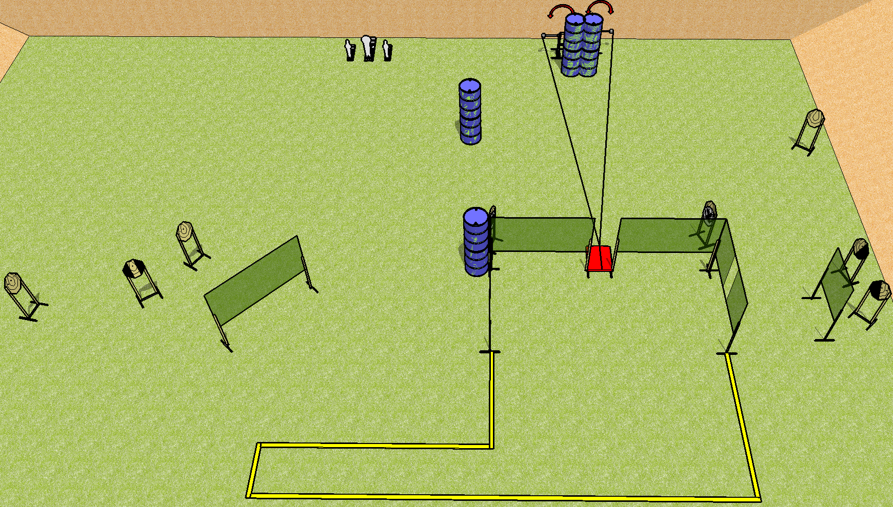
 | Dothan Practical Shooters – USPSA Match Tabletop Course Designer : Drew Coleman Bay: B2
Round Count 23 rounds 10 IPSC 2 mini, 1 colt
Equipment List 10 wall feet 1 tux, 1 left + 1 right diag 9 targets (7 + 2 NS)

Slide 2
Tabletop
Written Stage Briefing
Scoring: Comstock Rounds: 23
Targets: 10 IPSC, 3 steel
Start position: behind table, hands touching marks. Firearm is unloaded and unpropped, left or right of stomp pad. First magazine to be used is on opposite side of table.
Stage Procedure: on the audible start signal, engage targets as they become available from within the shooting area. The swingers are activated by the stomp pad and remain visible at rest.

